Slide 1
Bellabeat
4/13/2022
By Heather Shaw

Slide 2
Business Task
Bellabeat
High-tech manufacturer of health-focused products for women
Identify trends in non-Bellabeat smart tracker devices.
Identify ways these trends could apply to Bellabeat customers and products.
Apply these trends to influence Bellabeat marketing strategy.

Slide 3
The Data
FitBit Fitness Tracker Data – made available by Amazon Mechanical Turk – open source
31 days of fitness tracker data
33 participants
Date Range 4.12.2016 – 5.12.2016
Considerations
Short duration
Small sample size
Dated – six years old
Gaps in some metrics

Slide 4
The Data
*Tracker input for Daily Activity, including:
Activity level / intensity
Activity time
Distance
Calories
*Tracker input for Daily Sleep, including:
Sleep time
Total time in bed
*Weight data, including:
Weight in kg and lbs.
Manual data input or not manual
*Additional tables for activity measurements by hour or minute. For this analysis we focused on the three tables above.

Slide 5
Data Cleaning
SQL
Transformed string data types into dates and numeric values to prepare for calculations
Deleted 3 duplicate rows from the Sleep table
Checked for missing or incomplete data.
During this step, a wide variation between the number of entries in the Daily Activity, Sleep, and Weight tables was observed.
Daily Activity table contained multiple entries where all metrics were measured as 0. These entries were left in the table for reference, but they were excluded from calculations regarding tracker use.

Slide 6
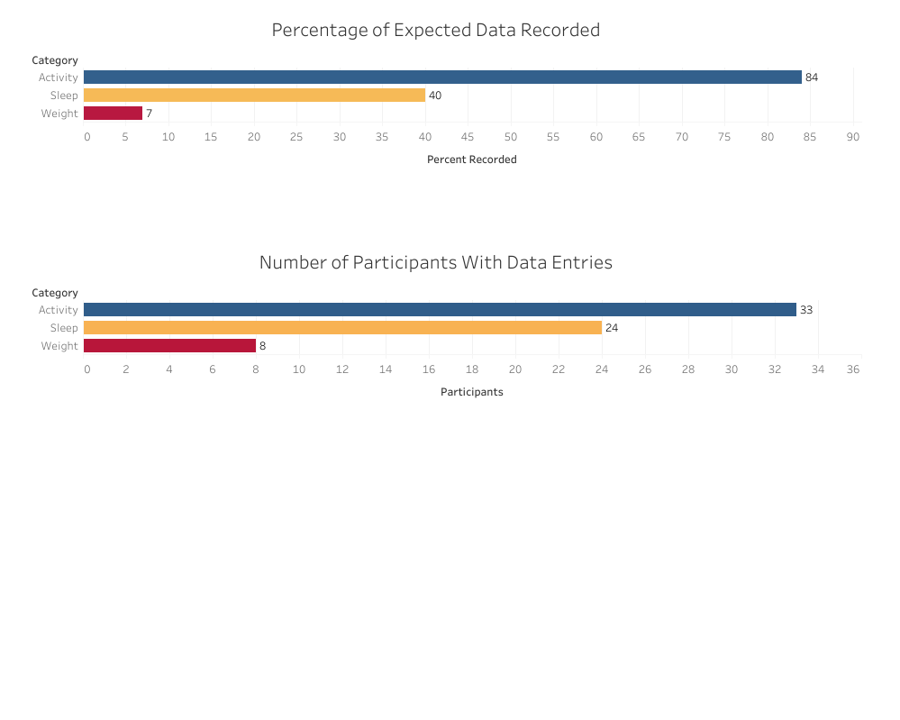
Calculating for 31 entries from 33 participants, a complete data set would be expected to include 1,023 total entries for category.
All participants had entries for Daily Activity, but not for Sleep or Weight tracking.

Slide 7
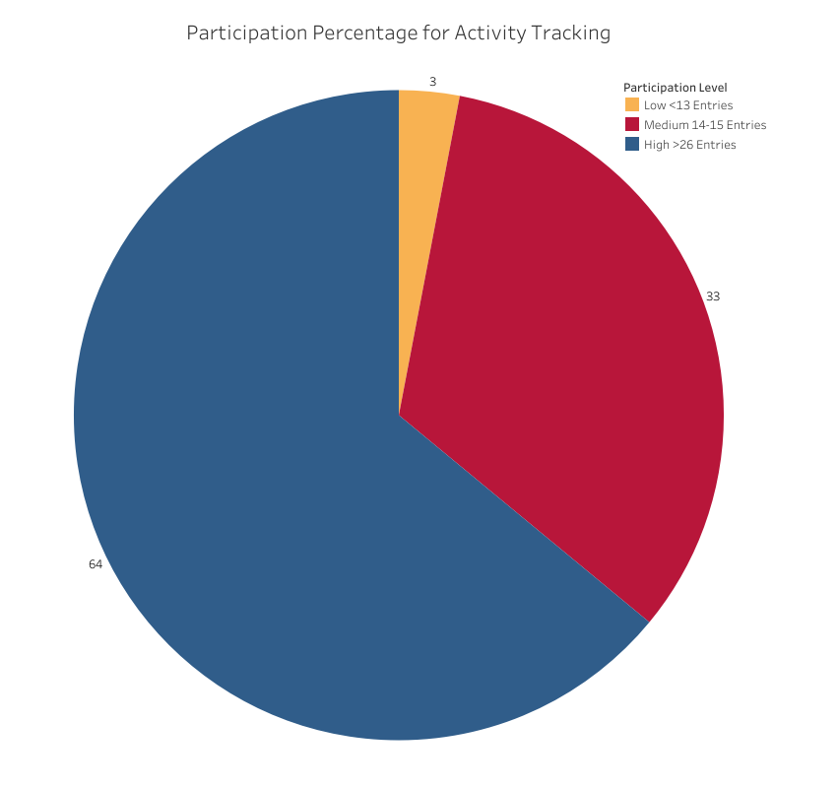
Daily Activity had the most consistent data.
Participants were grouped by level of participation - the number of Daily Activity entries over the 31-day study period.

Slide 8
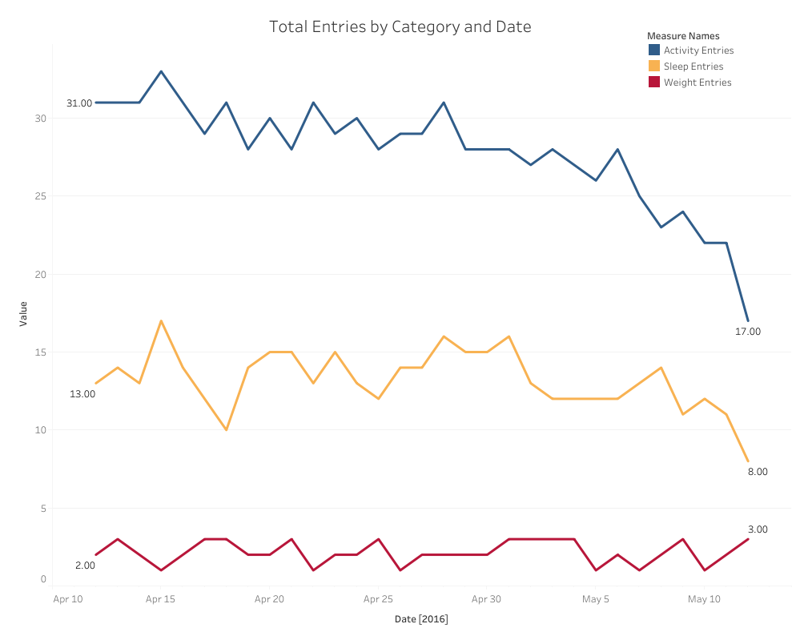
Daily Activity had the most consistent data, but participation lagged during the last week of the study
Daily Sleep had 24 participants, but tracking was inconsistent. The number of daily entries only ranged between 8 – 17.
Only 8 participants logged weight at any point in the study. The number of daily entries ranged between 1-3.

Slide 9
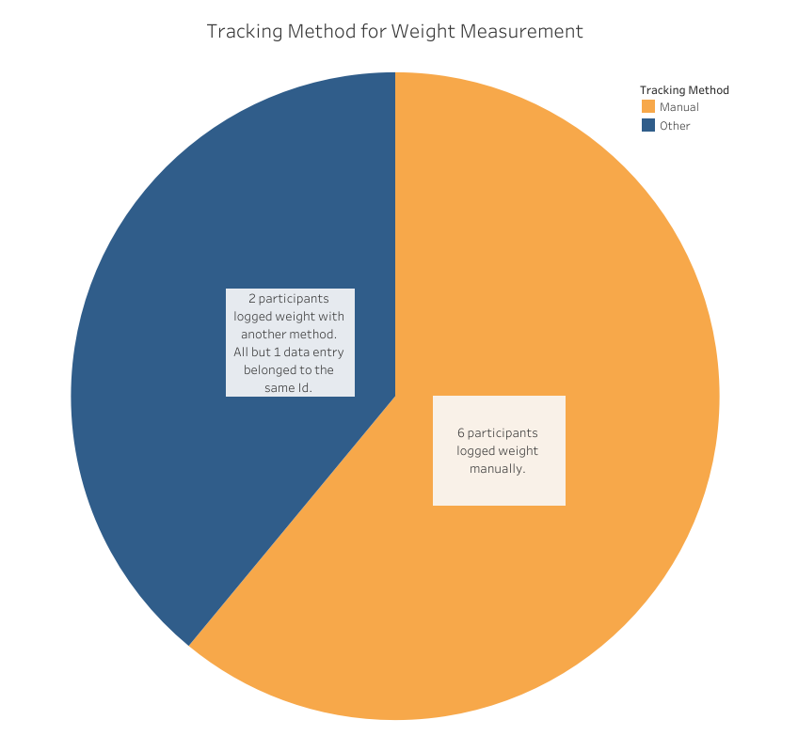
Of the 8 participants who tracked weight, most were entering data manually.
Data is extremely limited for this metric.

Slide 10
Analysis
The most frequently recorded data was Daily Activity, which was directly input from the fitness tracker.
This indicates that smart devices that enter automatically are more likely to be used for tracking.
There are large gaps in the data for Daily Sleep and Weight measurements.
Why? Potential causes:
Comfort level of device while sleeping
Lack of interest in tracking this information
Ease / convenience of using smart devices for tracking weight
There are significant limits to this data: limited time, small sample size, and age of data are all factors that could affect these results.

Slide 11
Bellabeat Products & Implications
Spring
Water bottle tracks daily water intake using smart technology.
Connects to Bellabeat app so users can track hydration levels automatically.
Automated data input from the fitness tracker had the most consistent use throughout the study period. Users interested in tracking water intake could find this feature very appealing.

Slide 12
Bellabeat Products & Implications
Leaf
Classic wellness tracker that can be worn as a bracelet, necklace, or clip. Connects to Bellabeat app for automatic tracking.
If comfort and ease of use are factors that affected participation level in Sleep tracking, the versatility of how the product can be worn could have a positive impact on the decision to use this product for health tracking.
More data is needed to definitively make this connection.

Slide 13
Bellabeat Products & Implications
Bellabeat App
Manual data entry may be appealing for tracking some metrics.
Automated data was the most consistent. For weight tracking, consider a feature that allows input to the app from smart scales that are not Bellabeat products.

Slide 14
Recommendations
More Data
Gather up-to-date tracker data from customers currently using Bellabeat products
Survey data
Gain insights from current and potential users about the factors that impact their decision to purchase and consistently use fitness trackers.
Clarify which metrics potential users wish to track.

